Slide 1

M. Tech. Project Seminar
Epilepsy seizure detection in EEG signal using Deep Learning
Session (2020-21)
Department of Computer Science and Engineering
M. Tech. (CSE & CS-IS)
Supervised By :-
Dr. Haider Banka
Associate Professor
Computer Science & Engineering
Submitted By :-
Harsh Yadav
19MT0153

Slide 2
Content
Introduction
What is Epilepsy, Seizure, Electroencephalography (EEG)
Different EEG signals (Normal vs Inter-Ictal vs Ictal )
Abstract
Keyword Explanation
Recurrent Neural Network ( RNN )
Long Short-Term Memory (LSTM)
Gated Recurrent Unit (GRU)
Stacked RNN
Bidirectional RNN
Dataset
Methodology
Steps & Architecture
Model Configuration
Result
Best model and its Architecture
Real time EEG detection and Result
Conclusion
References

Slide 3
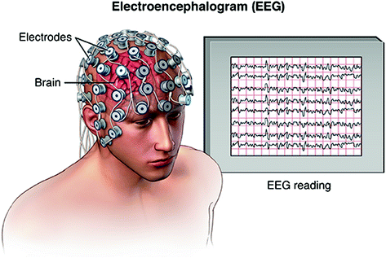
1.Introduction
Seizure: A seizure is a sudden, uncontrolled electrical disturbance in the brain. It can cause changes in your behavior, movements or feelings.
Seizure signs and symptoms: It may include temporary confusion, uncontrollable jerking movements of the arms and legs or loss of awareness , clenching your teeth, biting your tongue.
Epilepsy: Epilepsy is a central nervous system (neurological) disorder in which brain activity becomes abnormal, characterized by two or more unprovoked seizures.
Electroencephalography ( EEG): EEG test is used to evaluate the
electrical activity in the brain. An EEG can be used to help detect potential
problems like epilepsy.

Slide 4
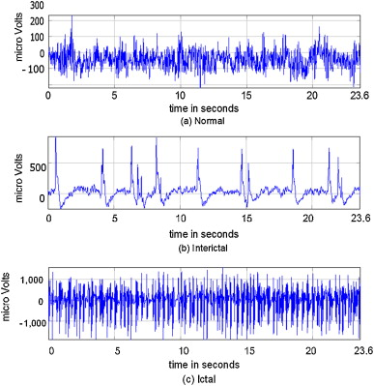
1b. Different EEG signals
Normal EEG signal : EEG signal of a healthy person
(Set A & B)
Inter-Ictal EEG signal : EEG signal between seizures.
(Set C & D)
Ictal EEG signal: EEG signal during seizures.
(Set E)

Slide 5
2. Abstract
In the proposed work, for the detection of epilepsy seizure in EEG signal, we have compared various models like LSTM & GRU (and their variants like Stacked, Bidirectional, etc.) based on accuracy, sensitivity, and specificity. And find out that Bidirectional LSTM works best for detecting epilepsy seizure in all cases.
After that, we tested our model on smaller EEG signals (having time-duration 3sec, 6sec, and 12sec, etc), which can help us in detecting real time seizures.
K-class classification of epilepsy seizure :-
2 Class Classification (Normal vs Ictal)
3 Class Classification (Normal vs Inter-ictal vs Ictal)
5 Class Classification (Normal_1 vs Normal_2 vs Inter-ictal_1 vs Inter-ictal_2 vs Ictal)

Slide 6
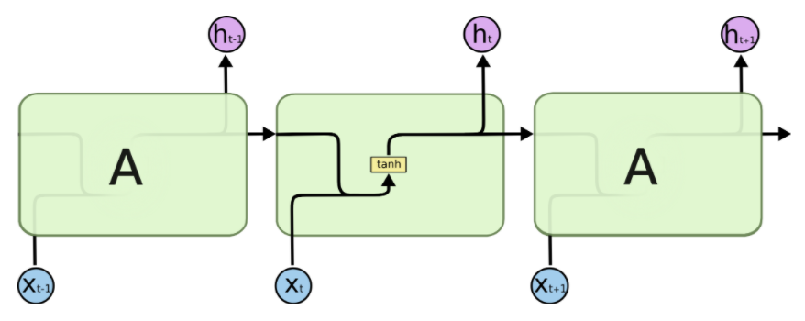

3a. Keywords Explanation
Recurrent Neural Network (RNN)
Fig 1a: An unrolled recurrent neural network (above)
Fig 1b: Repeating module of traditional RNN
RNNs, are a class of neural networks that allow previous outputs to be used as inputs while having hidden states. They are used in sequence problem or data that are based on time-series.
Advantage: Possibility of processing input of any length, Computation considers historical information, Weights are shared across time
Drawbacks: Computation being slow, Difficulty of accessing information from a long time ago Vanishing/exploding gradient

Slide 7
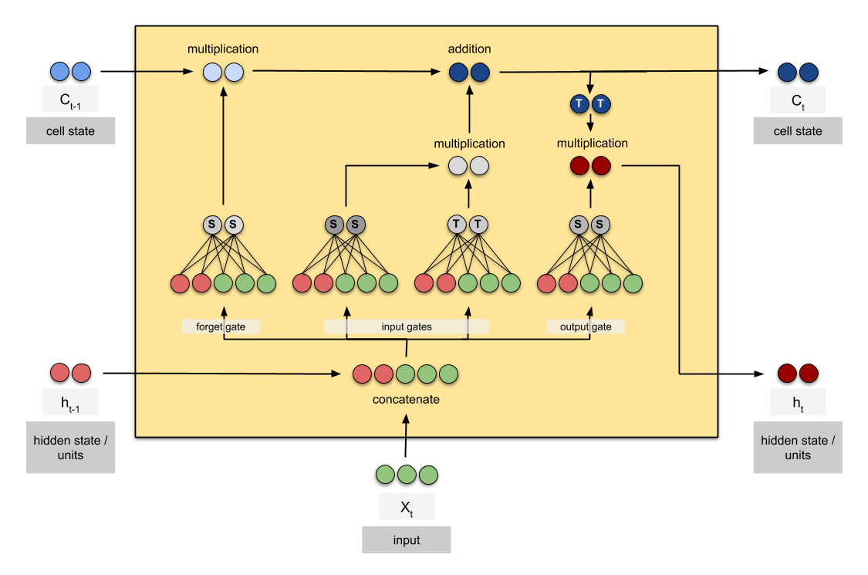
3b. Keywords Explanation
2. Long Short-Term Memory (LSTM)
LSTM are a special kind of RNN, capable of learning long-term dependencies.
LSTM networks are a modified version of RNN, which makes it easier to remember past data in memory.(No vanishing gradient problem in LSTM)
In an LSTM network, three gates are present:
Forget gate : discover what details to be discarded from the block
Input gate: discover which value from input should be used to modify the memory.
Output gate : the input and the memory of the block is used to decide the output.
Fig 2: Inside LSTM repeating module

Slide 8
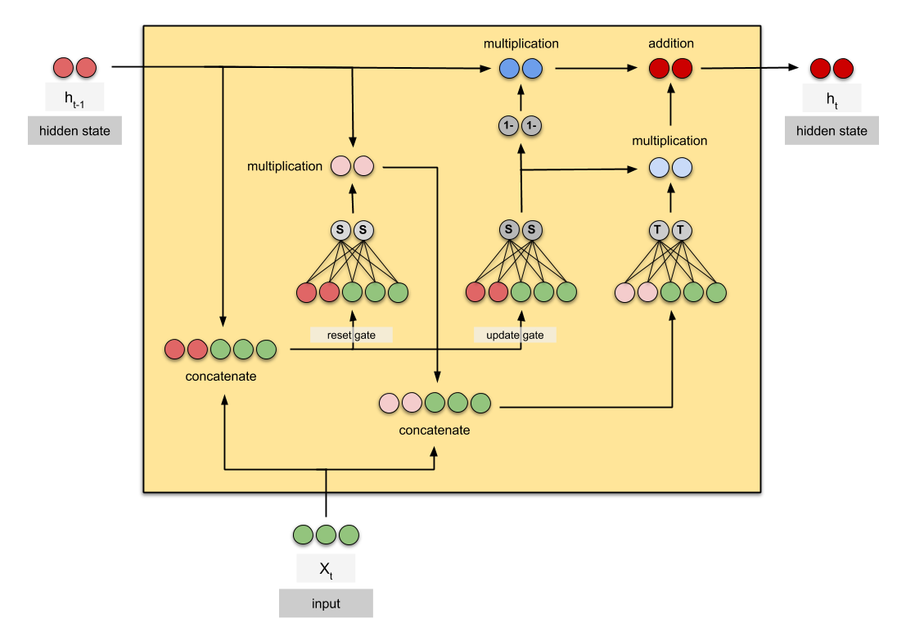
3c. Keywords Explanation
3. Gated Recurrent Unit ( GRU )
GRUs are similar to LSTM but with less training parameters and hence it trains faster than LSTM
In an GRU network, two gates are present:
Update gate : How much past information should matter now
Reset gate: Drop previous information ?
Fig 2: Inside GRU repeating module

Slide 9
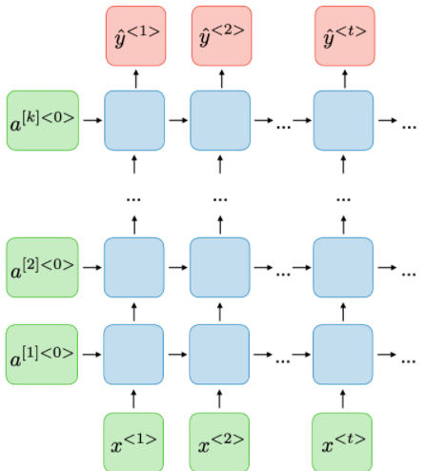
3d. Keywords Explanation
4. Stacked /Deep RNN (DRNN)
The Deep RNN is a model that has multiple hidden LSTM/GRU layers where each layer contains multiple memory cells.
We can use either Stacked LSTM or Stacked GRU.
In stacked LSTMs, each LSTM layer outputs a sequence of vectors which will be used as an input to a subsequent LSTM layer.
Why DRNN? Like additional hidden layers can be added to a Multilayer Perceptron neural network to make it deeper and more accurate . The same benefits can be harnessed with LSTMs, hence with stacked LSTM models are able to learn more complex features
Fig 3: Deep RNN

Slide 10
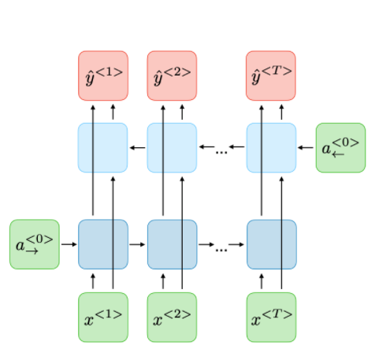
3e. Keywords Explanation
5. Bidirectional RNN (BRNN)
Bidirectional recurrent neural networks (BRNN) connect two hidden layers running in opposite directions to a single output (allowing them to receive information from both past and future states).
The input sequence is fed in normal time order for one network, and in reverse time order for another.
The outputs of the two networks are usually concatenated or added at each time step. This structure allows the networks to have both backward and forward information about the sequence at every time step .
We can use either Bidirectional LSTM or Bidirectional GRU.
Ex: “I love apple……..they make best electronic gadget.” Clearly the end of the phrase (if available) conveys significant information about which word “apple”, hence in this case we will need Bidirectional RNN
Fig 2: Architecture of BRNN

Slide 11
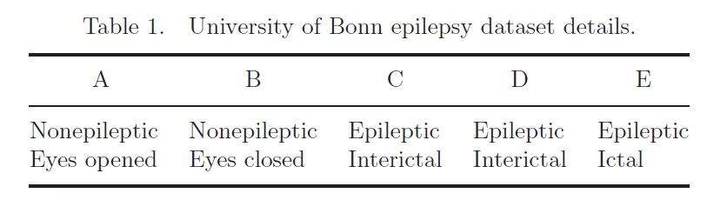
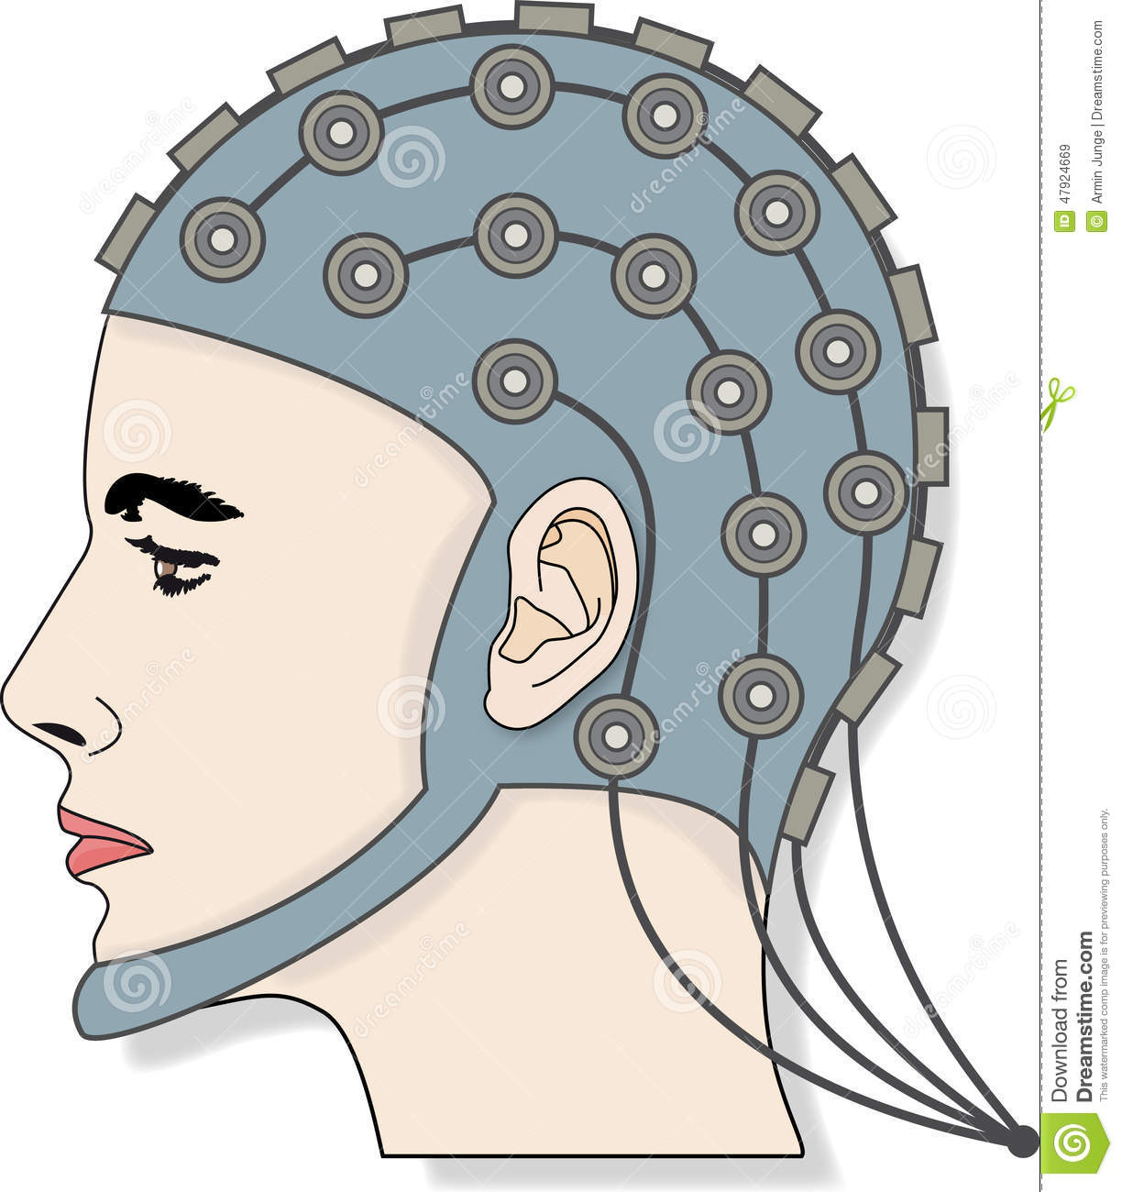

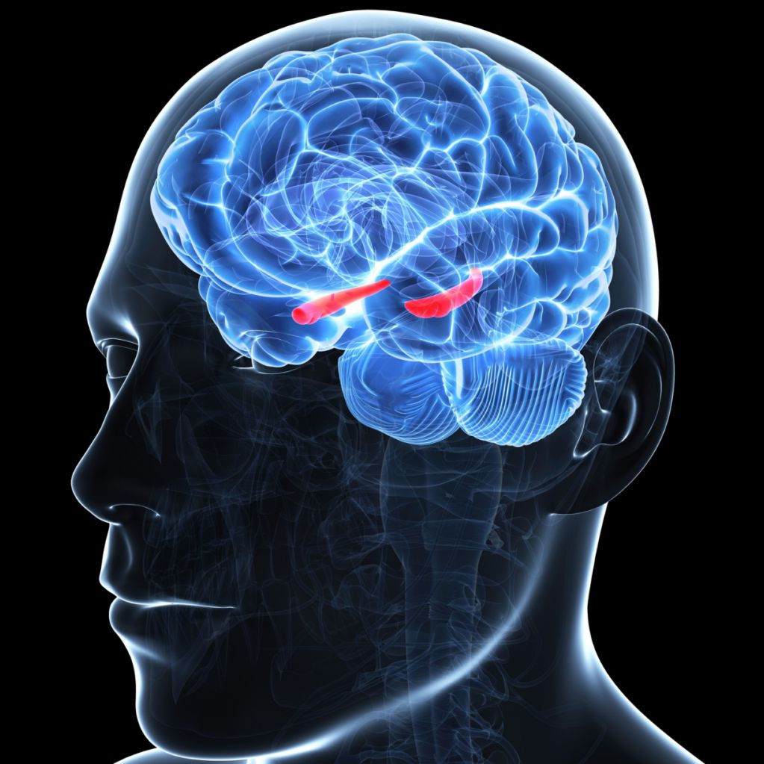
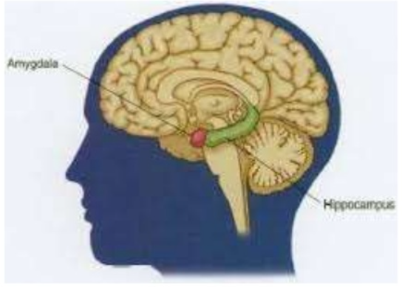
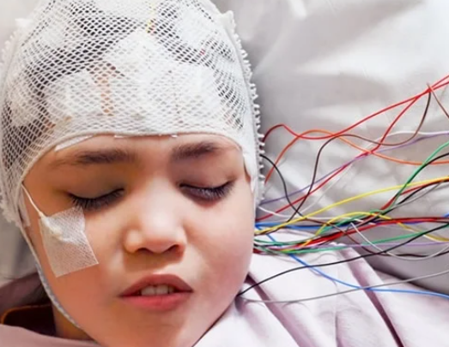
4. Dataset
Dataset: Widely used and publicly available EEG database produced by Bonn University. This database is divided into five diverse sets named A, B, C, D, and E. Each of these sets has 100 time-series EEG signals, each of which is 23.6 seconds time span.
Set A: Normal Eyes Open
Set B: Normal Eyes Closed
Set C: Epileptic interictal in Epileptic zone
Set D: Epileptic interictal in the hippocampal formation
Set E: Epileptic Ictal

Slide 12



5a. Methodology
Data Preparation
Original Dataset was divided into five Folders (each folder represents one class) and each folder contains 100 notepad files denoting 100 records of EEG signals. Each TXT-file consists of 4096 samples of one EEG time series in ASCII code.
A
CSV
B
CSV
CSV
C
CSV
Python code
D
CSV
E
CSV
Original Dataset
Code that convert 100 txt file into one csv file
Each csv file represent 100x4096 csv file
Combined CSV file of 500*4096 with class label

Slide 13
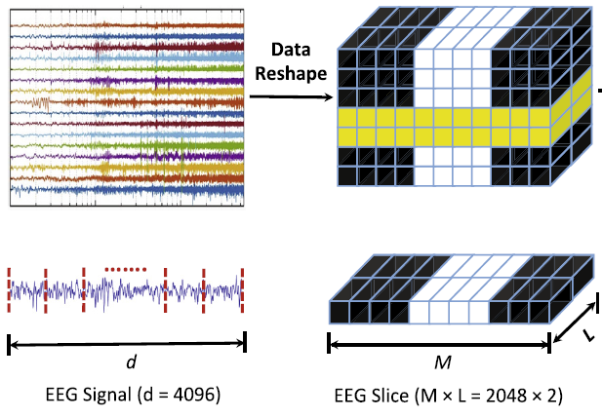
5b. Methodology
2. Data Preprocessing
Data Reshape (EEG Segmentation):
Changing data shape from 2D i.e., 500 * 4096, to 3D i.e., 500 * 2048 * 2.
As LSTM / GRU accept input in 3D format
500 x 2048 x 2
500 x 4096

Slide 14
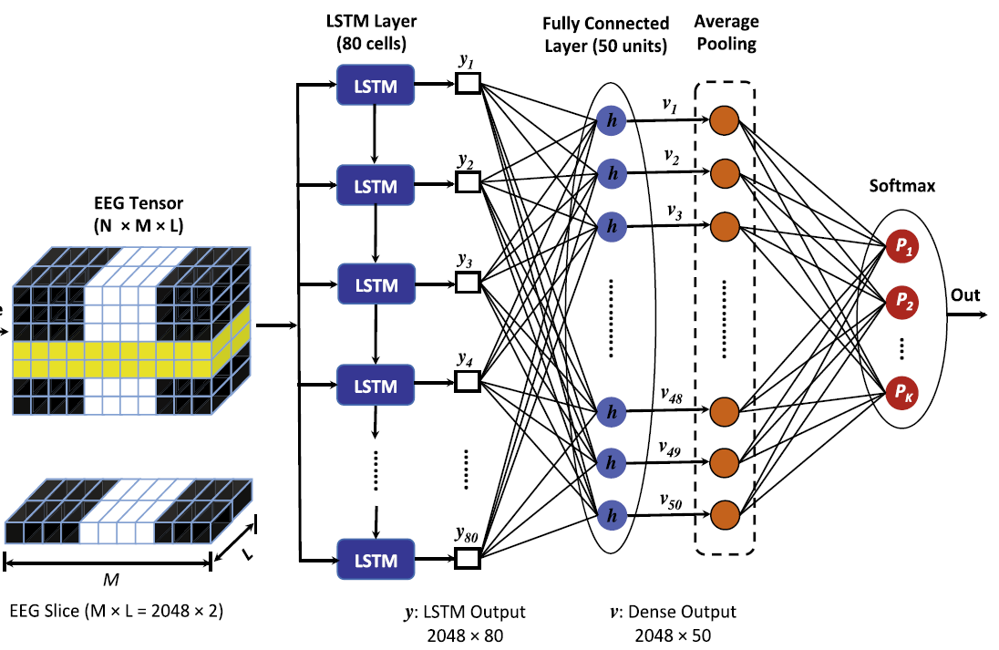
5c. Methodology
EEG data is first passed through an LSTM layer of 80 neurons. (helps in learning short and long-term dependencies between the EEG )
Output of LSTM is passed to fully connected dense layer (50 units) to translate the information learned by the LSTM layer into meaningful seizure-associated features.
Output of the FC layer is passed through a one-dimensional average pooling layer. The motivation for this was that all the EEG segments should contribute equally to the label prediction.
The output of the average pooling layer is then presented as an input to the softmax layer for EEG classification.
X₀
X₁
X₂
500*2048*2
X₂₀₄₇
Fig 5c: Schematic diagram of seizure detection approach (Orange box & Blue box changes respectively for 2class, 3class & 5 class classification problem)

Slide 15
6. Model configuration
Configuration and Hyperparameter | Value
Loss | Categorical cross-entropy
Optimizer | Adam
Learning rate | 1 x 10⁻³
Neurons in LSTM/GRU | 80
Cells in FC | 50
Batch size | 64
Dropout | 0.1
Epoch | 100 (in most cases)

Slide 16
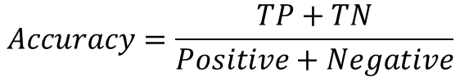
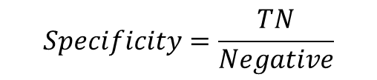
Two Class Classification (Normal vs Ictal)
For the two-class classification, Dataset was reduced to only two classes :-
A vs E (200 * 4096)
ABCD vs E (500 * 4096)
In the Fig 5C, we have replaced orange box with softmax 2 neurons as we are having two-class classification problem.
2 Class Type | RNN Type Architecture (Blue Box) | Accuracy | Specificity | Sensitivity
A vs E | LSTM (Single Layer) | 100% | 100% | 100%
 | Bidirectional LSTM | 100% | 100% | 100%
 | GRU (Single Layer) | 100% | 100% | 100%
ABCD vs E | Bidirectional LSTM | 100% | 100% | 100%
$$Accuracy=\frac{TP+TN}{Positive+Negative}$$
$$Specificity=\frac{TN}{Negative}$$
$$Sensitivity=\frac{TP}{Positive}$$

Slide 17
Three Class Classification (Normal vs Inter-Ictal vs Ictal)
For the three-class classification, Dataset was reduced to only three class
AB vs. CD vs. E [500*4096]
A vs. C vs. E [300*4096]
In the fig 5c, we have replaced orange box with softmax 3 neurons as we are having three-class classification problem.
3 Class Type | RNN Type Architecture (Blue Box) | Accuracy | Specificity | Sensitivity
AB vs CD vs E | LSTM ( Single Layer ) | 98.00% | 99.06% | 98.12%
 | LSTM (Stacked) | 96.00% | 99.06% | 98.12%
 | LSTM (Bi-Directional) | 98.67% | 98.30% | 96.59%
 | GRU ( Single Layer ) | 97.33% | 98.61% | 97.22%
 | GRU (Stacked) | 96.00% | 97.98% | 95.97%
 | GRU (Bi-Directional) | 98.00% | 98.92% | 97.84%
A vs C vs E | LSTM (Bi-Directional) | 98.00% | 96.35% | 97.35%

Slide 18
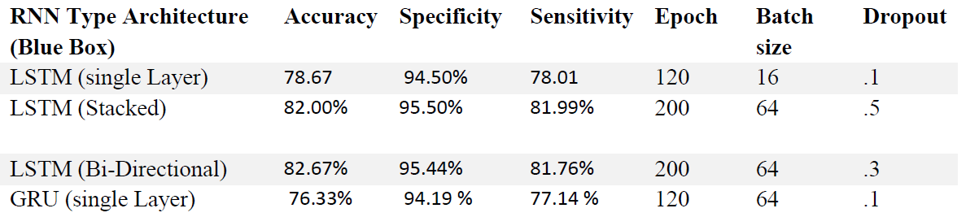
Five Class Classification (A vs B vs C vs D vs E)
For the five-class classification, Dataset remained same as original dataset contain five classes i.e. class A ,B ,C ,D and E.
And Size of dataset remained same i.e. 500*4096 as no class were removed.
In the fig 5c, we have replaced orange box with softmax 5 neurons as we are having five-class classification problem.

Slide 19
8. Best model
Best model for detection of Epilepsy seizure from EEG signal is Bidirectional LSTM.
Classification Problem | Dataset | RNN Type Architecture | Accuracy | Specificity | Sensitivity
2 Class Problem | A vs E | LSTM (Bi-Directional) | 100% | 100% | 100%
 | ABCD vs E |  | 100% | 100% | 100%
3 Class Problem | AB vs CD vs E |  | 98.67% | 99.06% | 98.12%
 | A vs C vs E |  | 98.00% | 96.35% | 97.35%
5 Class Problem | A vs B vs C vs D vs E |  | 82.67% | 95.44% | 81.76%

Slide 20
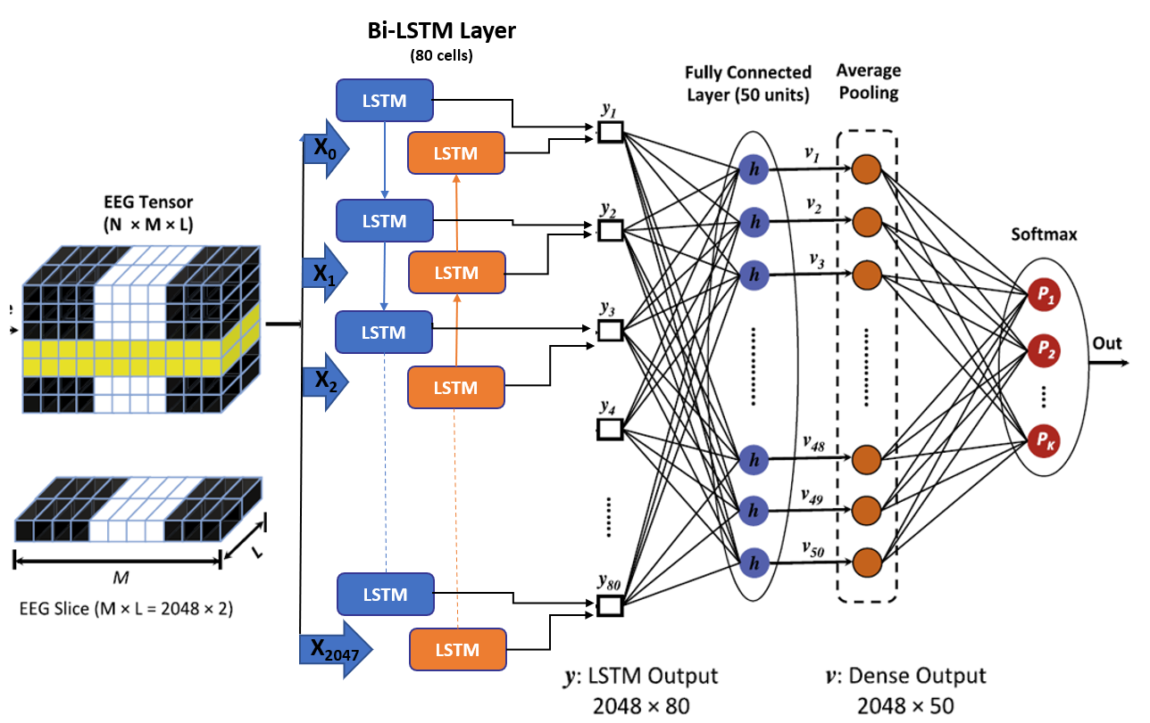
8. Best model architecture
Schematic diagram of seizure detection approach (Bi-Directional LSTM)

Slide 21
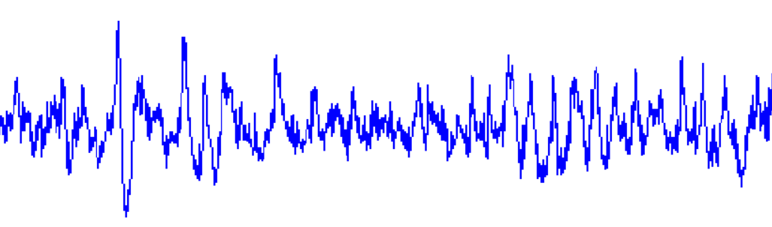
9. Real-time EEG detection
Current method for the detection of epilepsy seizure is to record EEG signal of 23.6sec and send this signal to the model for knowing its class.
Model
Output
(YES / NO)
EEG Signal of 23.6 sec
For real-time detection, we will take a window of size t (t< 23 sec) from the EEG signal & send it to our trained model.
Window of size t
At T=0, this window will be sent to model
At T=t, this window will be sent to model
At T=2t, this window will be sent to model
At T=3t, this window will be sent to model
At T=4t, this window will be sent to model
At T=5t, this window will be sent to model

Slide 22
9. Real-time EEG detection Result
Dataset | Time-Duration (t) | Accuracy | Sensitivity | Specificity | Loss
A vs. E | 23.6/2 = 11.8 sec | 100 % | 100 % | 100 % | .0022
A vs. E | 23.6/4 = 5.9 sec | 100 % | 100 % | 100 % | .0012
A vs. E | 23.6/8 = 2.95 sec | 100 % | 100 % | 100 % | .0147
ABCD vs. E | 23.6/2 = 11.8 sec | 100 % | 100 % | 100 % | .0029
ABCD vs. E | 23.6/4 = 5.9 sec | 100 % | 100 % | 100 % | .0018
ABCD vs. E | 23.6/8 = 2.95 sec | 100 % | 100 % | 100 % | .0132
2 Class Classification for different value of ‘t’
Dataset | Time-Duration (t) | Accuracy | Sensitivity | Specificity | Loss
AB vs.CD vs. E | 23.6/2 = 11.8 sec | 96.51 % | 98.05 % | 96.25 % | .0225
AB vs.CD vs. E | 23.6/4 = 5.9 sec | 96.28 % | 98.12% | 96.37 % | .0315
AB vs.CD vs. E | 23.6/8 = 2.95 sec | 96.35 % | 97.68% | 97.29 % | .0587
A vs. C vs. E | 23.6/2 = 11.8 sec | 96.37 % | 96.35 % | 98.17 % | .0852
A vs. C vs. E | 23.6/4 = 5.9 sec | 99.21 % | 99.23 % | 99.61 % | .0588
A vs. C vs. E | 23.6/8 = 2.95 sec | 97.91 % | 97.16 % | 98.97 % | .0486
3 Class Classification for different value of ‘t’

Slide 23
10. Conclusion
After checking different variants of LSTM & GRU, we came to conclusion that Bi-Directional LSTM perform best in all cases (2class, 3class & 5class classification)
For real time detection of epilepsy seizure from EEG signal we use window of different time duration and in all cases Bi-Directional LSTM gave accuracy of 98% approx.

Slide 24
11. References
1. Ramy Hussein, Hamid Palangi, Rabab K. Ward , Z. Jane Wang 2018. Optimized deep neural network architecture for robust detection of epileptic seizures using EEG signals. Clinical Neurophysiology 130 (2019) 25–37
2. Ihsan Ullah a , Muhammad Hussain b , ∗, Emad-ul-Haq Qazi b , Hatim Aboalsamh b An automated system for epilepsy detection using EEG brain signals based on deep learning approach 2018. Expert Systems With Applications 107 (2018) 61–71
3. Subhrajit Roy, Isabell Kiral-Kornek, and Stefan Harrer. 2018 .ChronoNet: A Deep Recurrent Neural Network for Abnormal EEG Identification. arXiv:1802.00308v2 [eess.SP]
4. U Rajendra Acharya , Shu Lih Oh , Yuki Hagiwara , Jen Hong .Tan Deep convolutional neural network for the automated detection and diagnosis of seizure using EEG signals. Article in Computers in Biology and Medicine · September 2017

Slide 25
THANK YOU….

